Slide 1
Group assignment2
Shubhank Shirishkumar Shah
Cheuk Ying Lu
Fangji Chen
Vivek Jilesingh Maan
Jamal Khattab

Slide 2
Project summary
One of the biggest challenges faced by Airbnb hosts is determining the optimal price for their listings. With a large number of listings available, it can be difficult for hosts to set a price that is both competitive and profitable. Factors such as location, time of year, and amenities offered can all impact the demand for a particular listing. As a result, hosts are often faced with the difficult task of determining the right price for their listing in order to maximize their revenue while still attracting guests. This can be especially challenging for new or inexperienced hosts who are unfamiliar with the Airbnb market. By using a machine learning model trained on an Airbnb dataset, hosts can gain insights into the factors that impact the demand for their listing. This can help them set a more informed price that is based on market trends and historical data. The model can take into account various factors such as location, time of year, number of bedrooms and bathrooms, and more, in order to make accurate predictions about the optimal price for a listing.

Slide 3
Research
Project Paper about Predicting Airbnb Prices in Different City
[Research Paper 1] Predicting Airbnb prices with machine learning and deep learning
London
[Research Paper 2] Airbnb Price Prediction with Sentiment Classification
San Francisco
[Research Paper 3] Airbnb Price Prediction in the Age of Social Distancing
New York City
XGBoost Model
Most Effective

Slide 4
goal/solution
Goal
Using the MLJAR to prediction the price of airbnb listing for this particular city named "Nashville"
Use the Nashville Properties.csv
dataset of the project which include the information of the airbnb in Nashville.
In the research above, different city's dataset were used. It shows that the XGBoost model is the most effective airbnb price prediction. That the reason why we choose to use the XGBoost model from the MLJAR library to help us to do the training and prediction in our project.
After the prediction, hosts can gain insights on the factors that impact their demand. Accoding to the result, the host can set a more informed price.

Slide 5


Data exploration
Data understanding
Data preprocessing and cleaning

Slide 6

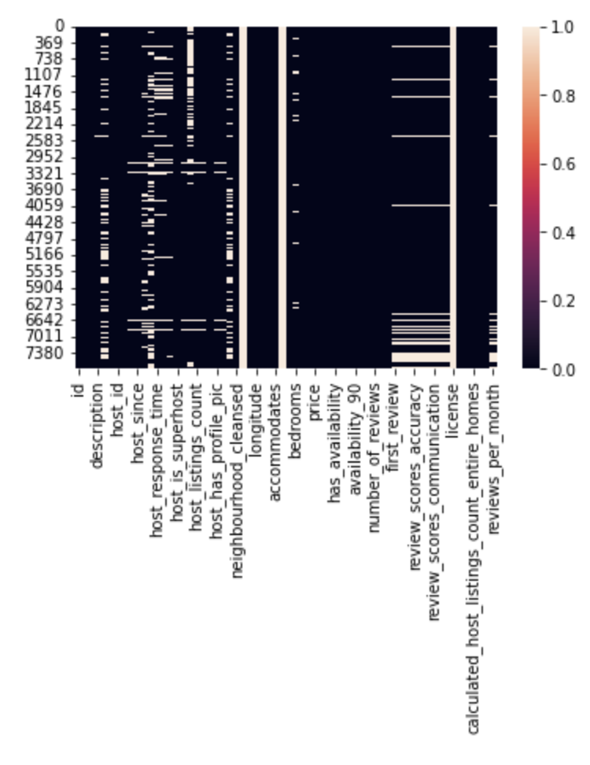
Data understanding
We can notice a variety of things from the dataset's head once it has been loaded.
We can perform deep data exploration on this dataset using the extremely rich amount of information that these columns supply.
We can already notice some missing data, thus processing and cleaning NaN values will be necessary.
Mapping specific values to ones and zeros may be necessary for predictive analytics.

Slide 7
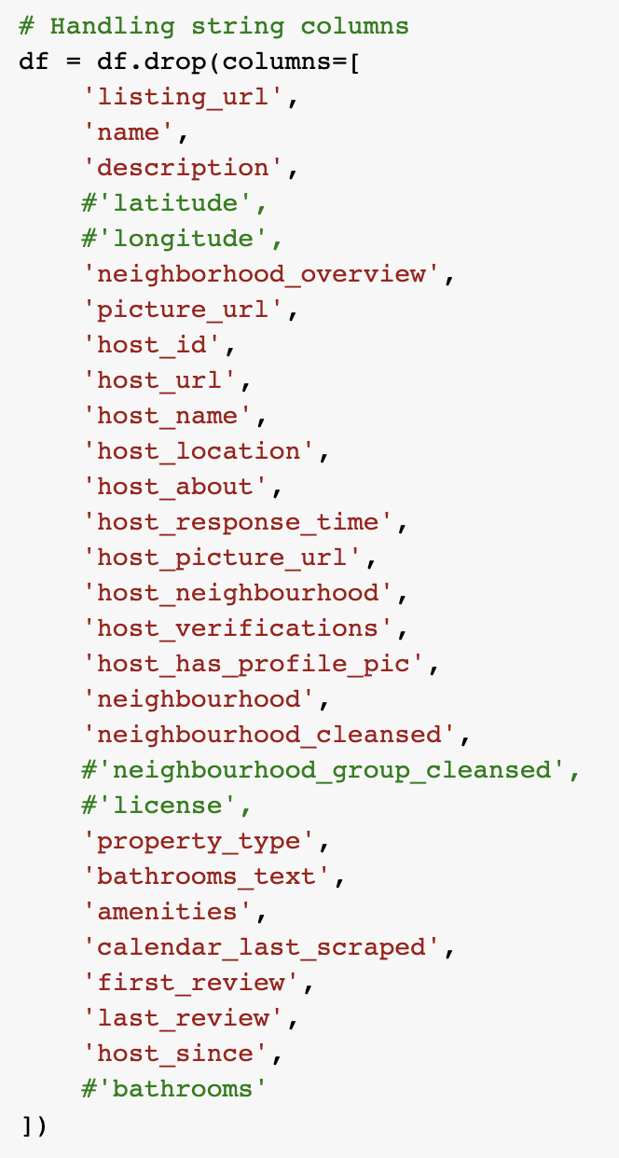
Data preprocessing
Some of the columns are unnecessary for this regression task, so we dropped them

Slide 8
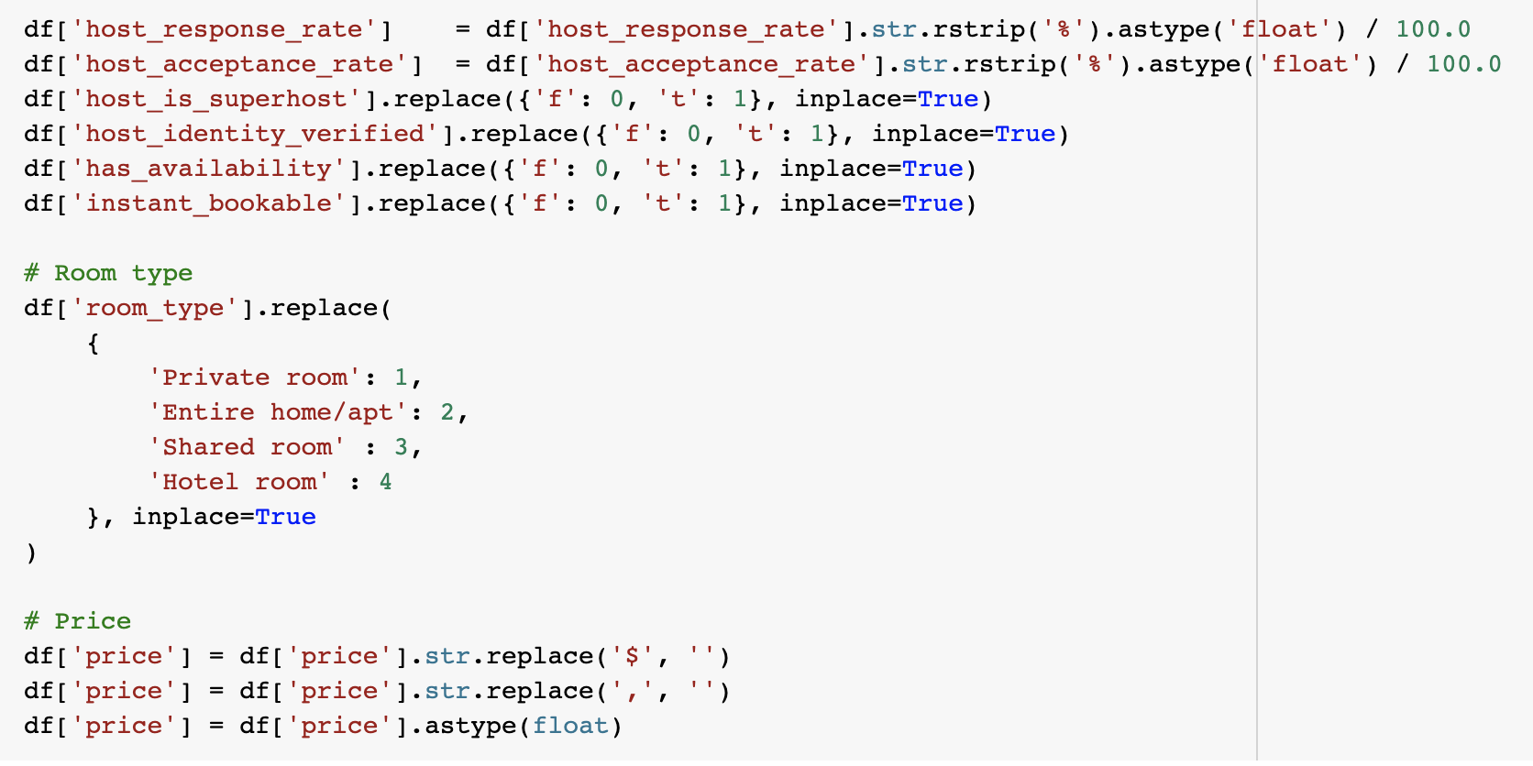
Data preprocessing
Some important features are transformed from categorical data into numerical data
Deal with null data in some features

Slide 9
Auto machine learning

Slide 10
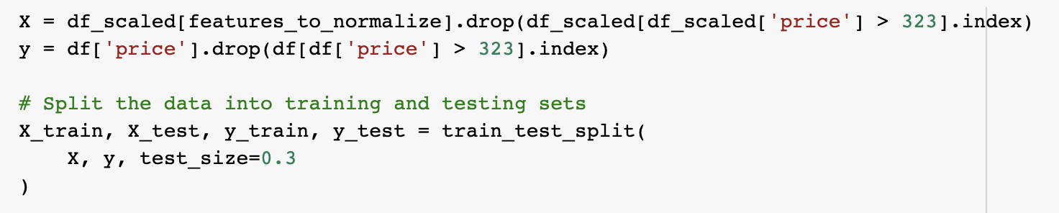
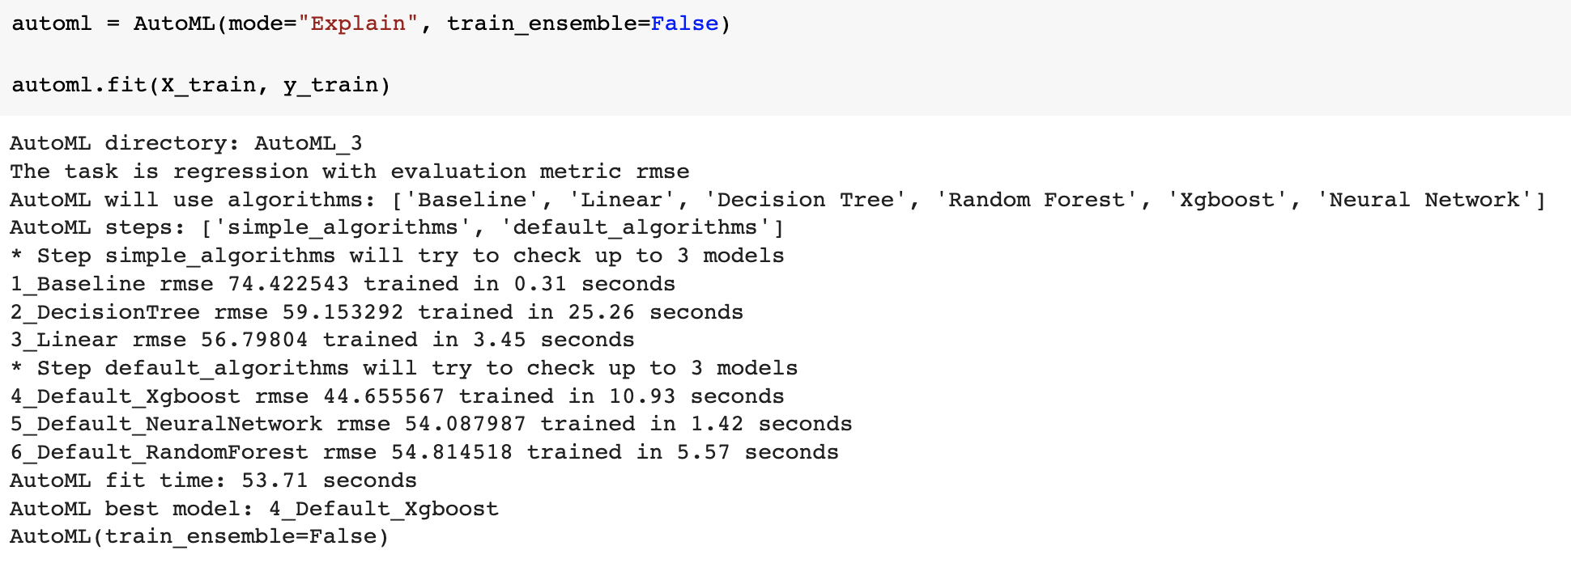
Model training and auto-selection
Raw data are shuffled and split into training data and test data at a ratio of 7:3
And trained with AutoML Module

Slide 11
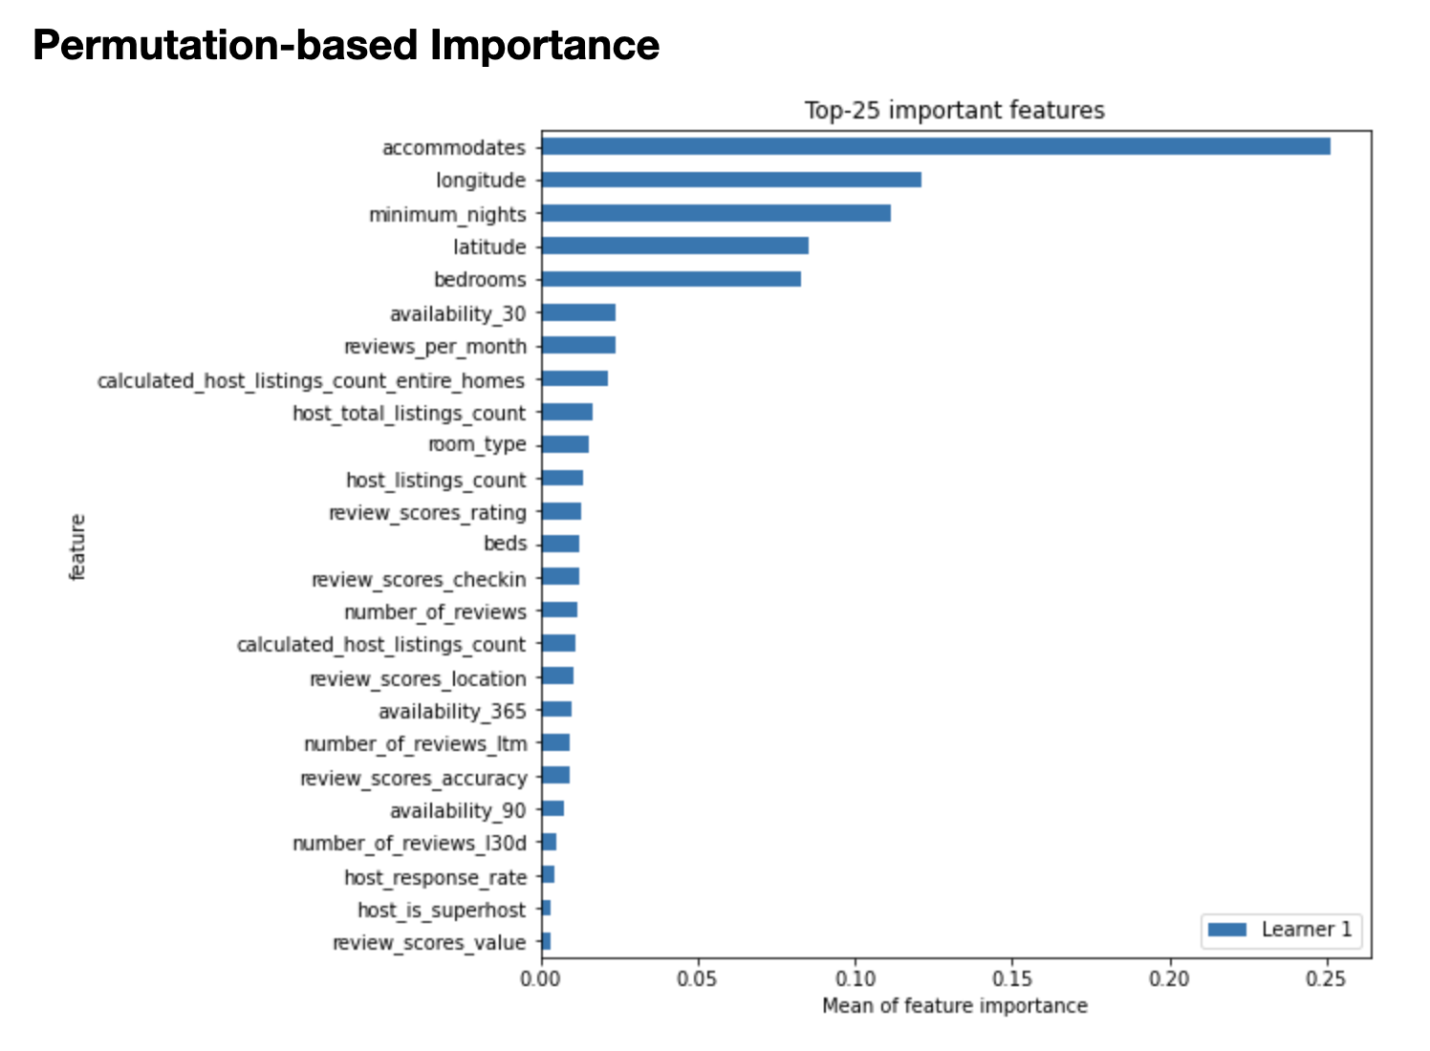
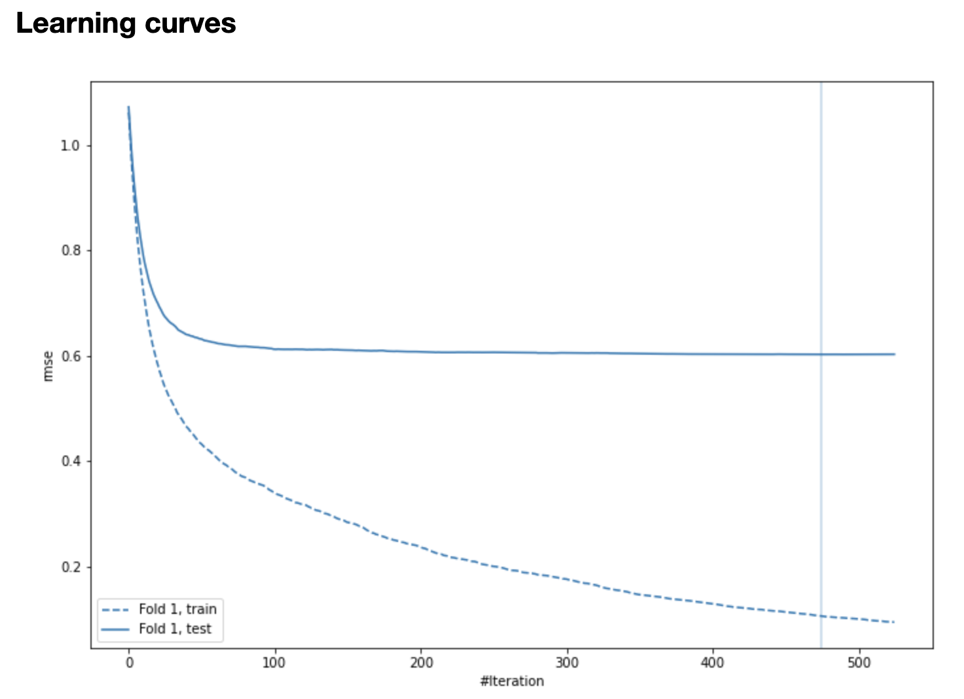
Model selection
As a result, xgboost is the best model
Accommodates, geo locations, minimum_nights and bedrooms are the most important feature in this dataset
The best MSE for testing data is 0.6

Slide 12
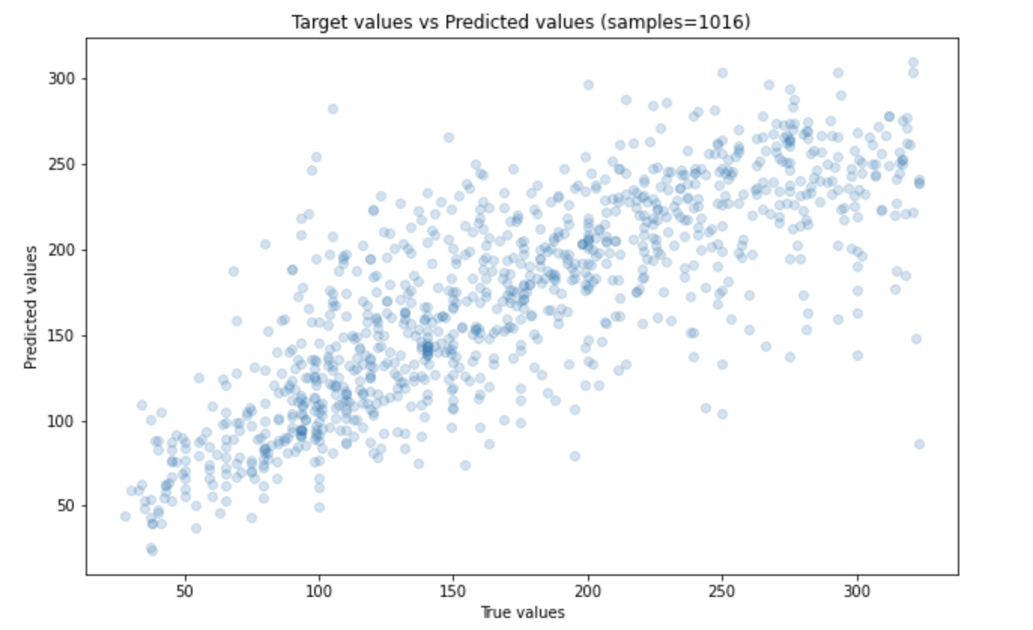
Model selection
As a result, as the plot shown on the right of this slide, our research proves that XGBoost was in fact the best model out of the following models: ['Baseline', 'Linear', 'Decision Tree', 'Random Forest', 'Xgboost', 'Neural Network']

Slide 13
Introduction to the results
Adding the suggested pricing as a new feature might increase the host’s willingness to use Airbnb.

Slide 14
improvements in the future

Slide 15
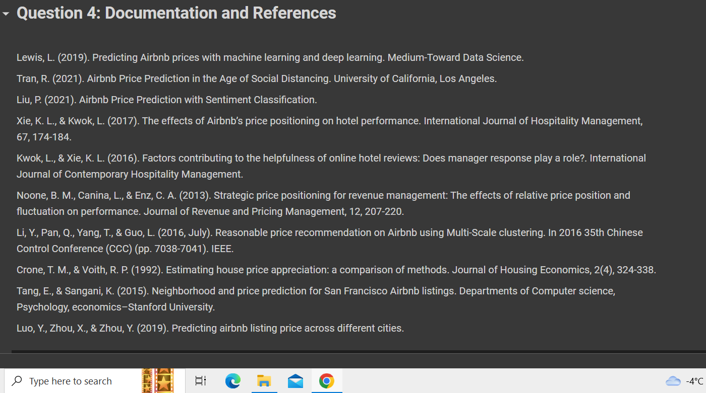
References

Slide 16
Thank you

